Slide 1
Cardiovascular Embryology-II
Dr. Suhas Alur S
SR Cardiology

Slide 2
Recap of key points

Slide 3
Recap
Cardiac embryogenesis
Majority of cardiac development begins from 15-18 days.
Human heart is completed at 10 weeks of IUL
Critical period 18-50 days

Slide 4
Recap
Germ lines
Ectoderm
Mesoderm
Endoderm
Majority of cardiac structures are derivatives of mesoderm with contribution from neuro-ectoderm and minimal from endoderm

Slide 5
Recap
Formation of bilateral heart fields
Formation of the heart tube
Folding of the heart tube
Looping of the heart tube
Chamber specification and compaction

Slide 6
Recap

Slide 7
Recap
Progenitor cells

Slide 8
Recap
Heart fields

Slide 9
Outline
Atrioventricular canal development
Conotruncal development and associated anomalies
Aortic arches development
Conduction system development
Pericardial sac development

Slide 10
Atrioventricular canal development
Atrioventricular valves develop during the fifth to eight week of gestation
Initially endocardial cushion tissue bulges at the atrioventricular junction.
These bulges although have appearance of valve and may play an important role in formation of AV valves, endocardial cushion tissues are not precursors of MV and TV
The formation of AV valve start when atria and inlet portion of ventricle enlarge; the atrioventricular junction lags behind, such a process leads to flap formation.

Slide 11
Formation of Atrioventricular canal

Slide 12
Formation of AV valves
The endocardial cushion tissue is located at the tip of this flap, formed of atrial tissue, inner ventricular tissue middle layer of invaginated sulcus tissue.
The inner sulcus tissue will eventually come in contact with cushion tissue at the tip of valve leaflets, thus interrupting the muscular continuity between the atria and ventricles

Slide 13
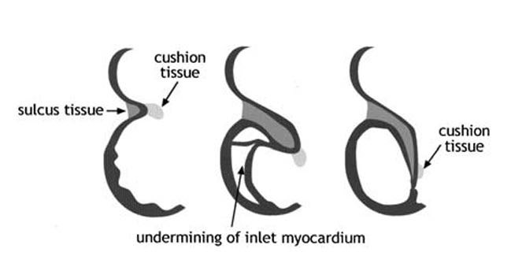
Atrioventricular canal development
Formation of atrioventricular valves

Slide 14
Formation of AV valves and PM

Slide 15
Clinical correlates
An arrest in the erosion of the AV valve apparatus – Mitral/ tricuspid atresia
Partial erosion: Foreshortened, tethered chordae/ single or bifid papillary muscles
Spectrum of mitral or tricuspid stenosis
Faulty myocardial erosion : LV non compaction

Slide 16
Conotruncal development and anomalies
Various definitions and terminologies have been proposed over time leading to confusion
The Conus- also known as Infundibulum (Keith 1909)
The Conotruncus comprises collectively two myocardial sub segments, (- D A Goor 1972)
BULBUS CORDIS –refers to the ventricular outflow tract
TRUNCUS ARTERIOSUS- embryologic precursor of great arteries.

Slide 17
Termininology
Bulbus cordis- also known as the conotruncus lies ventral to primitive ventricle.
Together with primitive ventricle it forms the ventricle of the formed heart.
The developing two main truncal cushions and the underlying two conal cushions are perfectly aligned and no line of demarcation between the two is identifiable in mammals
(Van Mierop and Patterson, 1980)

Slide 18
Terminologies

Slide 19
Terminology
The truncus arteriosus, the most distal portion of the developing cardiac outflow tract, bordering on the overlying aortic sac, is the short segment that, once septated, allows the division of the common outflow orifice into two separate arterial valves orifice. -Restivo et al (2006)

Slide 20
Restivo et al (2006)

Slide 21
Terminology
Conotruncus -The conotruncus is the outflow region of the developing heart. It consists of:
Conus- Inferior to the aortic and pulmonary valves .
Truncus- Superior to the valves that is continuous with the ventral aorta (aortic sac).

Slide 22
Development
Primitive cardiac tube Bulboventricular tube
Straight heart tube is formed by ventral midline fusion of myocardial and endothelial cells

Slide 23
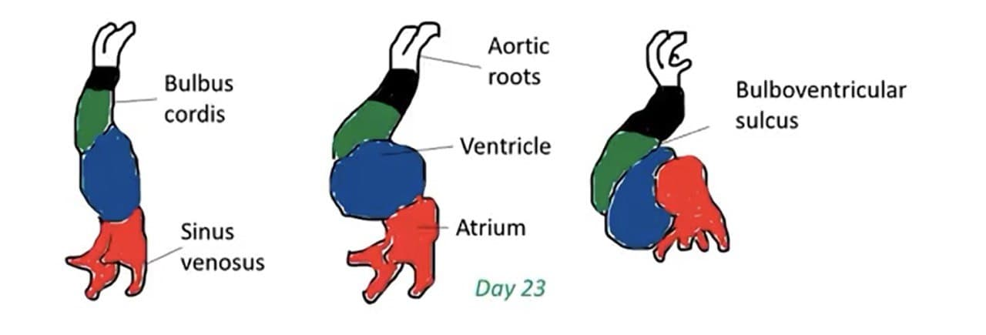
Development
As it elongates the cells are added from secondary heart field. This lengthening is needed for formation of RV and outflow tract and for the looping

Slide 24
Outflow region of the developing heart
Conotruncus = The Conus + Truncus
Conus : The myocardial segment between ventricle and semilunar valves which gives rise to subarterial coni
Truncus: The fibrous segment between semilunar valves and aortic sac which gives rise to great arteries

Slide 25
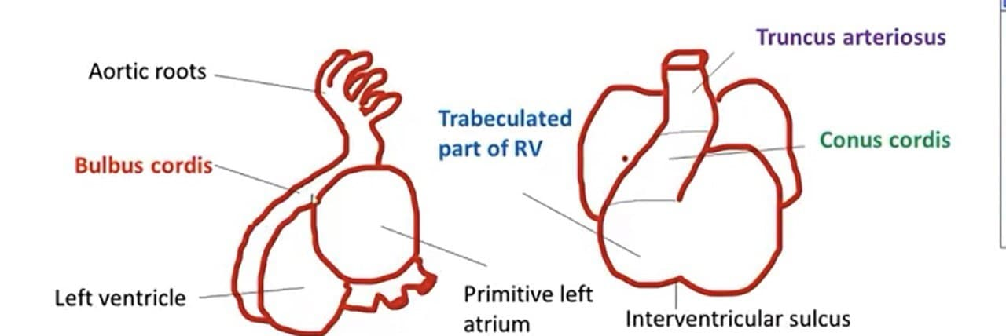
Bulbus cordis is narrow except the proximal third which forms the trabeculated part of RV
Mid portion is Conus Cordis that forms the outflow tract of both the ventricles
Distal part is the Truncus that forms the roots and proximal parts of aorta and pulmonary artery
Part between the proximal Bulbus cordis and primitive ventricle forms the IVS

Slide 26
Alert
Truncus in embryological terms should not be extended to common arterial trunk, which is an aortic sac derivative from which the suprasemilunar ascending aorta and pulmonary trunk arteries develop.
Conus is that position of the outflow tract proximal to ventricles, which after septation and rotation, persists in normal heart as subpulmonary infundibulum and it disappears by myocardial regressive absorption, on the subaortic side

Slide 27
Conotruncal development
Neural Crest contributes to endocardial cushion formation in conus and truncus arteriosus, semilunar valves and also controls cell production and lengthening of outflow region
Proliferation of following cell types needed
Secondary heart field
Neural crest cells
Myocardium
Endocardium

Slide 28
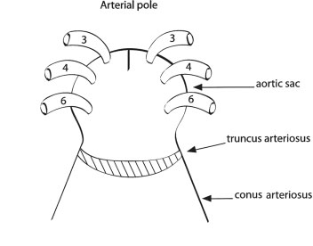
Truncus Arteriosus
Truncus Arteriosus – Short segment
Distal most potion of the developing outflow tract
Developing truncal endocardial cushions
Divides the common outflow tract into separate arterial valve orifices
Contributes to arterial valve leaflets

Slide 29
Truncus Arteriosus
Earlier stage , external wall of the truncal myocardium creates some sort of rim known as myocardial cuff which appears to cover the root of aortic sac
At the same time, two cushions appear at the aortic sac- truncus junction: The right superior towards the left and the left inferior towards the right causing a future spiral septum
Truncal cushions once fused form the truncal septum

Slide 30
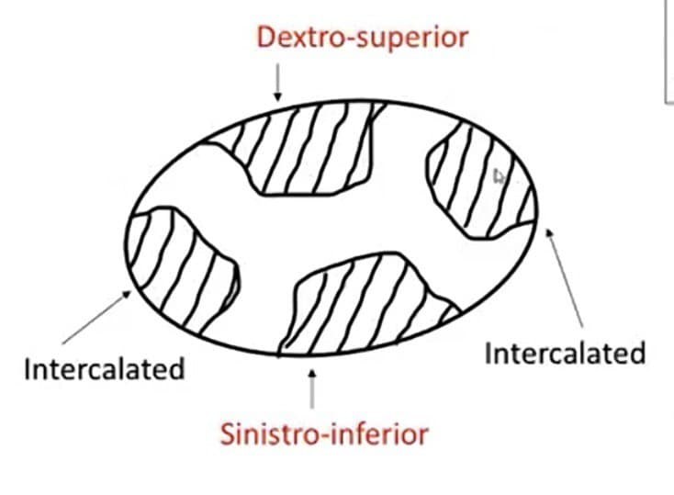
Truncal septum

Slide 31
When portioning of the truncus is almost complete, primordia of semilunar valves are seen as small tubercles on the main truncal swelling
After complex differentiation, forms right and left(posterior) pulmonary cusps and right and left (anterior) aortic cusps

Slide 32
Two additional parietal endocardial cushions appear on the right and left side
After the counterclockwise conotruncal rotation, the right cushion becomes the non coronary cusp and left becomes the anterior pulmonary cusp

Slide 33
Transverse section of truncus arteriosus at the level of semilunar valves

Slide 34
Subsequently, the myocardial cuff retracts downwards following the caudal translocation of the aortic sac and the whole conotruncus itself move caudally
This allows the development of intrapericardial portions of the great arteries and of the arterial walls of the sinuses of valsalva

Slide 35
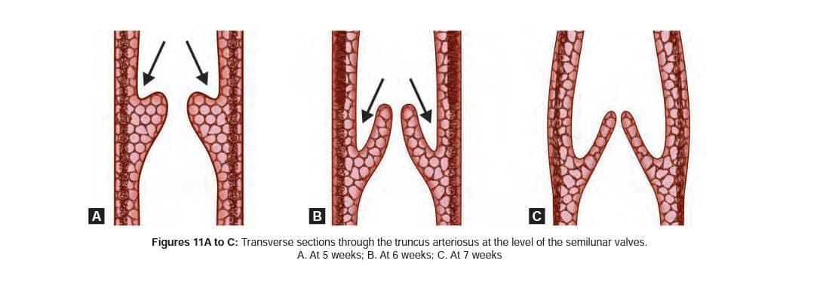
Excavation within the truncal and intercalated cushions produces a central luminal part of each cushion to form the arterial valvar leaflets, whereas the peripheral part becomes arterialised to form the supporting valvar sinuses

Slide 36
Conus cordis

Slide 37
Conus cordis
Same time when the truncal swellings appear, similar cushions appear in the right dorsal and left ventral wall of conus
They grow towards each other and distally unite with truncal septum
This septum divides into anterolateral portion i.e.; RVOT and posteromedial ie;LVOT

Slide 38
Sagital section

Slide 39
Conotruncal development

Slide 40
Conotruncal defects
Where can it go wrong ??
Insult to neural crest cells and disrupt formation of conotruncal septum
Insult to Neural crest that disrupt the signals to SHF
Direct insult to SHF
Basis for understanding abnormal facial features in children with Conotruncal abnormalities

Slide 41
Conotruncal defects
Failure of formation of conotruncal ridges leads to non division of outflow tract
Lack of formation of truncoconal septum
Gives rise to Truncus arteriosus
(Since the ridges are also responsible for formation of IVS, VSD is associated)
Partial truncoconal septal defect
AP window, Supracristal VSD

Slide 42
Conotruncal defects
Normal course if the conotruncal septum is 180 degrees rotation
Complete failure of rotation i.e.; 0 degrees
-Transposition of Great Arteries
90 degree rotation of conotruncus side by side vessels
DORV

Slide 43
Conotruncal defects
Uneven septation at the expense of pulmonary side resulting from anterior displacement of conotruncal septum leads to Tetrology of Fallot
Lack of development or uneven septation of conotruncus leads to PS/PA/AS/AA
Semilunar valves fused for variable distance leads to Valvular Stenosis of PA or Aorta

Slide 44
Summary
 | Truncus arteriosus | TGA | DORV
Conal Musculature | - | + | +
Conotruncal AP septations | - | + | +
Left sided Pulmonary portion of Conotruncus translocates leftward from RV to LV | + | + | -
Lack of conotruncal rotation | - | + | +

Slide 45
Aortic arches
Aortic sac forms the right and left horns
Each pharyngeal arch receives its own artery
Aortic arches arise from the aortic sac – the most distal part of truncal arteriosus and terminate in the right and left dorsal aortae

Slide 46
Aortic arches
Pharyngeal arches and their vessels appear in cranial to caudal sequence
There are total of 6(5) pairs of arteries (Fifth arch either never forms or forms and regresses)
3rd , 4th, 6th arches are large arches

Slide 47
Aortic arches
Right horn gives to brachiocephalic artery
Left horn to proximal segment of arch
3rd arch- Common carotid artery and first part of ICA (remaining ICA is from cranial portion of dorsal aorta), ECA sprouts from 3rd arch
4th arch-
Left side – part of arch of aorta between left CCA and left SCA
Right side – proximal segment of right SCA (distal part formed by portion of right dorsal aorta and 7th intersegmental artery)
6th arch (Pulmonary arch)- Right side- proximal part becomes proximal part of RPA, distal part disappears
Left side- Proximal part becomes part of LPA, distal persists as PDA

Slide 48
Aortic arches

Slide 49
Other Changes
Dorsal aorta between the entrance of 3rd and 4th arch (carotid duct) disappears
Right dorsal aorta disappears between the origin of 7th intersegmental artery and the junction with the left dorsal aorta

Slide 50
Other Changes
Carotid and brachiophalic arteries elongate as the heart is pushed into thorax
Hence the lest subclavian artery shifts its origin from aorta at the 7th intersegmental artery to close to left common carotid artery

Slide 51
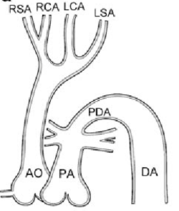
Arterial system defects
Interrupted arch of Aorta (IAA): Complete obliteration of 4th arch
Coarctation of Aorta: Partial obliteration of 4th arch

Slide 52
Arterial system defects
Patent ductus arteriosus: Lack of obliteration of distal left arch

Slide 53
Abnormal origin of RCA
RCA formed by distal portion of right dorsal aorta and 7th intersegmental artery, the right 4th aortic arch and proximal part of right dorsal aorta disappears

Slide 54
Abnormal origin of RCA

Slide 55
Double aortic arch
Double Aortic arch: Right dorsal aorta persists between the origin of 7th intersegmental artery and its junction with left dorsal aorta
No brachiocephalic artery
Vascular ring

Slide 56
Conduction system
Primary myocardium, found in the early heart tube, gives rise to contracting myocardium and the conducting myocardium(nodal and ventricular conducting tissues)
The embryological origin of SA and AV node is not clear
The ventricular conduction system starts with formation of an encircling ring of conducting myocardial tissue around the bi-ventricular foramen.
The dorsal portion will become the Bundle of His.
The portion of the ring covering the septum will become left and right bundle branches

Slide 57
Development of pericardial sac
The right and left intracelomic cavities approach the midline as the two tubes are fusing into a medial tube (day 21)
The ventral mesoderm immediately absorbs, the dorsal mesoderm persists until day 25
After the mesoderm is absorbed the heart becomes suspended from cranial to caudal ends
The band of connective tissue grows from the epicardium into the atrioventricular junction when the heart is four chambered, resulting in separation of atrial and ventricular myocardium
Thus Bundle of His remains as only electrical connection between atria and ventricle

Slide 58
Summing it up

Slide 59
Summing it up

Slide 60
Summing it up

Slide 61
Summing it up

Slide 62
Summing it up
Segment | Derivative | Remark
Sinus Venosi | SVC/IVC, smooth venous portions of both atria | Separated by common atrium by sinoatrial grove
Common atrium | Right and left atrial appendages | Separated from the primitive ventricle by AV canal.
Inlet segment (Primitive ventricle) | Apical and inlet portions of LV | Separated from outlet segment (bulbus cordis )by primary interventricular foramen (bulboventricular foramen)
Outlet segment (Bulbus cordis, conus) | Apical and inlet portions of RV outlet of both RV and LV | Contionous with truncus arteriosus
Truncus arteriosus proper and aortic sac | Proximal great arteries and paired aortic arches | Initially located in branchial mesenchyme; after looping becomes intrapricardial

Slide 63
The cardiac anlage

